Slide 1
Chapter 5: Risk Analysis and Simulation
Lecture 13
Institute of Engineering
Asst. Prof. Anita Prajapati, Ph.D.
26 July 2023

Slide 2
Risk Analysis
Chapter 12
Spreadsheet Modeling & Decision Analysis:
A Practical Introduction to Management Science, 3e
by Cliff Ragsdale

Slide 3
Introduction to Simulation
In many spreadsheets, the value for one or more cells representing independent variables is unknown or uncertain.
As a result, there is uncertainty about the value the dependent variable will assume:
Y = f(X₁, X₂, …, X_{k})
Simulation can be used to analyze these types of models.

Slide 4
Random Variables & Risk
A random variable is any variable whose value cannot be predicted or set with certainty.
Many “input cells” in spreadsheet models are actually random variables.
the future cost of raw materials
future interest rates
future number of employees in a firm
expected product demand
Decisions made on the basis of uncertain information often involve risk.
“Risk” implies the potential for loss.

Slide 5
Why Analyze Risk?
Plugging in expected values for uncertain cells tells us nothing about the variability of the performance measure we base decisions on.
Suppose an $1,000 investment is expected to return $10,000 in two years. Would you invest if...
the outcomes could range from $9,000 to $11,000?
the outcomes could range from -$30,000 to $50,000?
Alternatives with the same expected value may involve different levels of risk.

Slide 6
Methods of Risk Analysis
Best-Case/Worst-Case Analysis
What-if Analysis
Simulation

Slide 7
Best-Case/Worst-Case Analysis
Best case - plug in the most optimistic values for each of the uncertain cells.
Worst case - plug in the most pessimistic values for each of the uncertain cells.
This is easy to do but tells us nothing about the distribution of possible outcomes within the best-case and worst-case limits.

Slide 8
Possible Performance Measure Distributions Within a Range
worst case
best case
worst case
best case
worst case
best case
worst case
best case

Slide 9
What-If Analysis
Plug in different values for the uncertain cells and see what happens.
This is easy to do with spreadsheets.
Problems:
Values may be chosen in a biased way.
Hundreds or thousands of scenarios may be required to generate a representative distribution.
Does not supply the tangible evidence (facts and figures) needed to justify decisions to management.

Slide 10
Simulation
Simulation is a technique that measures the characteristics of the bottom-line performance measures of a model when one or more values for the independent variables are uncertain.
Resembles automated what-if analysis.
Values for uncertain cells are selected in an unbiased manner.
The computer generates hundreds (or thousands) of scenarios.
We can analyze the results of these scenarios to better understand the behavior of the performance measure and make decisions using solid empirical evidence.

Slide 11
Example: Hungry Dawg Restaurants
Hungry Dawg is a growing restaurant chain with a self-insured employee health plan.
Covered employees contribute $125 per month to the plan, Hungry Dawg pays the rest.
The number of covered employees changes from month to month.
The number of covered employees was 18,533 last month and this is expected to increase by 2% per month.
The average claim per employee was $250 last month and is expected to increase at a rate of 1% per month.

Slide 12
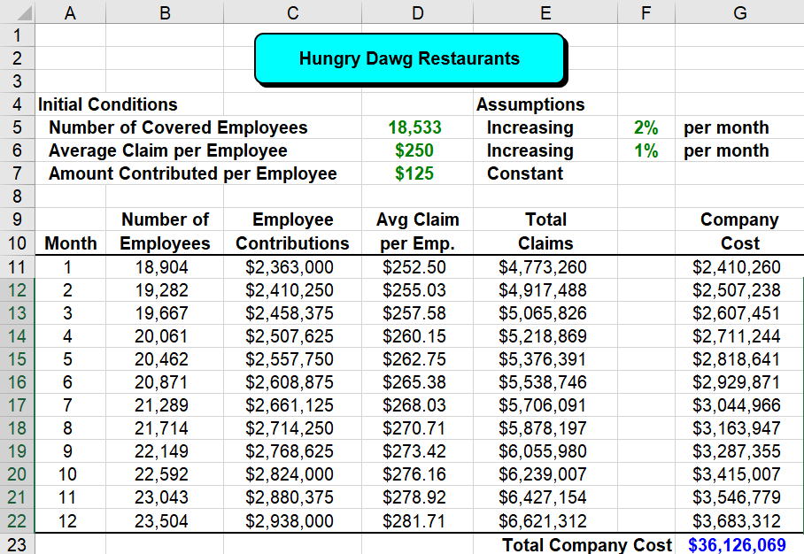
Implementing the Model
See file Fig12-2.xls

Slide 13
Questions About the Model
Will the number of covered employees really increase by exactly 2% each month?
Will the average health claim per employee really increase by exactly 1% each month?
How likely is it that the total company cost will be exactly $36,125,850 in the coming year?
What is the probability that the total company cost will exceed, say, $38,000,000?

Slide 14
Simulation
To properly assess the risk inherent in the model we need to use simulation.
Simulation is a 4-step process:
Identify the uncertain cells in the model.
Implement appropriate RNGs for each uncertain cell.
Replicate the model n times, and record the value of the bottom-line performance measure.
Analyze the sample values collected on the performance measure.

Slide 15
What is Crystal Ball?
Crystal Ball is a spreadsheet add-in that simplifies spreadsheet simulation.
It provides:
functions for generating random numbers
commands for running simulations
graphical & statistical summaries of simulation data
For more info see: http://www.decisioneering.com

Slide 16
Random Number Generators
A RNG is a mathematical function that randomly generates (returns) a value from a particular probability distribution.
We can implement RNGs for uncertain cells to allow us to sample from the distribution of values expected for different cells.

Slide 17
How RNGs Work
The RAND() function returns uniformly distributed random numbers between 0.0 and 0.9999999.
Suppose we want to simulate the act of tossing a fair coin.
Let 1 represent “heads” and 2 represent “tails”.
Consider the following RNG:
=IF(RAND()<0.5,1,2)

Slide 18
Simulating the Roll of a Die
We want the values 1, 2, 3, 4, 5 & 6 to occur randomly with equal probability of occurrence.
Consider the following RNG:
=INT(6*RAND())+1
If 6*RAND( ) falls INT(6*RAND( ))+1
in the interval: returns the value:
0.0 to 0.999 1
1.0 to 1.999 2
2.0 to 2.999 3
3.0 to 3.999 4
4.0 to 4.999 5
5.0 to 5.999 6

Slide 19
Some of the RNGs Provided by Crystal Ball
Distribution RNG Function
Binomial CB.Binomial(p,n)
Custom CB.Custom(range)
Gamma CB.Gamma(loc,shape,scale,min,max)
Poisson CB.Poisson(λ)
Continuous Uniform CB.Uniform(min,max)
Exponential CB.Exponential(λ)
Normal CB.Normal(μ,σ,min,max)
Triangular CB.Triang(min, most likely, max)

Slide 20
Examples of Discrete Probability Distributions

Slide 21
Examples of Continuous Probability Distributions

Slide 22
Discrete vs. Continuous Random Variables
A discrete random variable may assume one of a fixed set of (usually integer) values.
Example: The number of defective tires on a new car can be 0, 1, 2, 3, or 4.
A continuous random variable may assume one of an infinite number of values in a specified range.
Example: The amount of gasoline in a new car can be any value between 0 and the maximum capacity of the fuel tank.

Slide 23
Preparing the Model for Simulation
Suppose we analyzed historical data and found that:
The change in the number of covered employees each month is uniformly distributed between a 3% decrease and a 7% increase.
The average claim per employee follows a normal distribution with mean increasing by 1% per month and a standard deviation of $3.

Slide 24
Revising & Simulating the Model
See file Fig12-8.xls

Slide 25
The Uncertainty of Sampling
The replications of our model represent a sample from the (infinite) population of all possible replications.
Suppose we repeated the simulation and obtained a new sample of the same size.
Q: Would the statistical results be the same?
A: No!
As the sample size (# of replications) increases, the sample statistics converge to the true population values.
We can also construct confidence intervals for a number of statistics...

Slide 26
Constructing a Confidence Interval for the True Population Mean
where:
Note that as n increases, the width of the confidence decreases.

Slide 27
Constructing a Confidence Interval for the True Population Proportion
where:
Note that as n increases, the width of the confidence decreases.

Slide 28
Benefits of simulation
Through simulation of the mathematical model, we can have a whole range of probable values for the output variable, this provides the engineer or the manager with better insight and perspective for more informed decision-making process.

Slide 29
Additional Uses of Simulation
Simulation is used to describe the behavior, distribution and/or characteristics of some bottom-line performance measure when values of one or more input variables are uncertain.
Often, some input variables are under the decision makers control.
We can use simulation to assist in finding the values of the controllable variables that cause the system to operate optimally.
The following examples illustrate this process

Slide 30
An Reservation Management Example: Piedmont Commuter Airlines
PCA Flight 343 flies between a small regional airport and a major hub.
The plane has 19 seats, several of which are often vacant.
Tickets cost $150 per seat.
There is a 0.10 probability of a sold seat being vacant.
If PCA overbooks, it must pay an average of $325 for any passengers that get “bumped”.
Demand for seats is random, as follows:
What is the optimal number of seats to sell?
Demand 14 15 16 17 18 19 20 21 22 23 24 25
Probability .03 .05 .07 .09 .11 .15 .18 .14 .08 .05 .03 .02

Slide 31
Implementing & Simulating the Model
See file Fig12-19.xls

Slide 32
Inventory Control Example: Millennium Computer Corporation (MCC)
MCC is a retail computer store - where competition is fierce.
Stock outs are occurring on a popular monitor.
The current reorder point is 28.
The current order size is 50.
Daily demand and order lead times vary randomly as follows:
Units Demanded: 0 1 2 3 4 5 6 7 8 9 10
Probability: 0.01 0.02 0.04 0.06 0.09 0.14 0.18 0.22 0.16 0.06 0.02
Lead Time (days): 3 4 5
Probability: 0.2 0.6 0.2
MCC’s owner would like to determine the reorder point and order size that will provide a 98% service level while keeping the average inventory as low as possible.

Slide 33
Implementing & Simulating the Model
See file Fig12-26.xls

Slide 34
A Project Selection Example: TRC Technologies
TRC has $2 million to invest in the following new R&D projects.
Revenue Potential
Initial Cost Prob. Of ($1,000s)
Project ($1,000s) Success Min Likely Max
1 $250 0.9 $600 $750 $900
2 $650 0.7 $1250 $1500 $1600
3 $250 0.6 $500 $600 $750
4 $500 0.4 $1600 $1800 $1900
5 $700 0.8 $1150 $1200 $1400
6 $30 0.6 $150 $180 $250
7 $350 0.7 $750 $900 $1000
8 $70 0.9 $220 $250 $320
TRC wants to select the projects that will maximize the firm’s expected profit.

Slide 35
Implementing & Simulating the Model
See file Fig12-34.xls

Slide 36
Risk Management
The solution that maximizes the expected profit also poses a significant (≈10%) risk of losing money.
Suppose TRC would prefer a solution that maximizes the chances of earning at least $1 million while incurring at most a 5% chance of losing money.
We can use OptQuest to find such a solution...

Slide 37
Simulation modeling with Crystal Ball
Crystal Ball automates the complex tasks required in Monte Carlo Simulations, such as generating random variates, replicating the model calculations, aggregating results, and computing statistics, and developing necessary graphs and charts.

Slide 38
Simulation modeling with Crystal Ball
The main key tool bars are as follows:
Define assumptions (input variables) – defines a probability distribution for spreadsheet cell value
Define forecast (output variable) – define a cell as simulation output for which statistics will be generated
Select assumptions – show all assumption cells in the worksheet

Slide 39
Simulation modeling with Crystal Ball
Select forecasts – show all forecast cells in the worksheet
Run preferences – choose run preferences, such as number of trials, sampling method, and other features
Start simulation (Run menu) – start simulation run
Stop simulation (Run menu) – stop simulation run
Single step (Run Menu) – perform a single trial run of simulation

Slide 40
Simulation modeling with Crystal Ball
Create report (Run menu) – generate a report of the output statistics based on the simulation run
Crystal Ball requires two sets of cells in a spreadsheet model for running simulation
Assumption cells – cells that represent uncertain inputs in the simulation model
Forecast cells – cells that represent the outputs of the simulation model.

Slide 41
Example (simple profitability model)
Unit Price | $450.00
Sales Volume (uncertain) | 1,000
Unit Variable cost (uncertain) | $250.00
Fixed cost | $100,000.00
Model
Operating Profit (?) | $100,000.00

Slide 42
Example 2: Project features
A hydropower plant of 900 KW needs an investment of Rs 10 crores.
Tax rebate for 15 years. (NEA) price at Rs 3.40 per KWh. Escalation rate at 6% for the initial five years, but after five years constant.
The economic life : 15 years. The annual O & M cost : 5% of the revenue. The annual escalation rate for the O & M cost is 5%. The Hydropower plant to be handed over to the Govt. after 15 years.
The fixed assets are 95% of the investment. The annual insurance cost is 0.25% of revenue.

Slide 43
Project features
The annual capital expenditure : 2.5% of the revenue. The Hydropower plant has to be handed over to the Govt. after 15 years.
Develop a Discounted Cash Flow (DCF) model for the project and find out whether the project is feasible or not.

Slide 44
Assignment -8
Chapter 12
Question no.: 2,3,4,6,7,9,11,12,13,14,15,17,18,24,26,27
Due date: 4 August 2023

